Slide 1

Makerspace Raspberry Pi
Workshop 2: Computer Vision With Python and OpenCV

Slide 2

What is an image?
Visual perception by an observer
Distribution of intensity of color over a two dimensional space

Slide 3
Common Image Formats
You may be familiar with compressed formats such as .jpeg, .png, etc.
For computer vision we mostly work with uncompressed image formats
For example, 640*480 RGBA8 image could be contained by an array with the following dimensions: [480][640][4]

Slide 4
RGBA8
An RGB8 image stores intensity values between 0-255 for red, green, blue, and alpha channels
To look at a specific channel, we can use indexing such as image[y, x, c]
An alpha channel represents transparency for the only three channels.

Slide 5
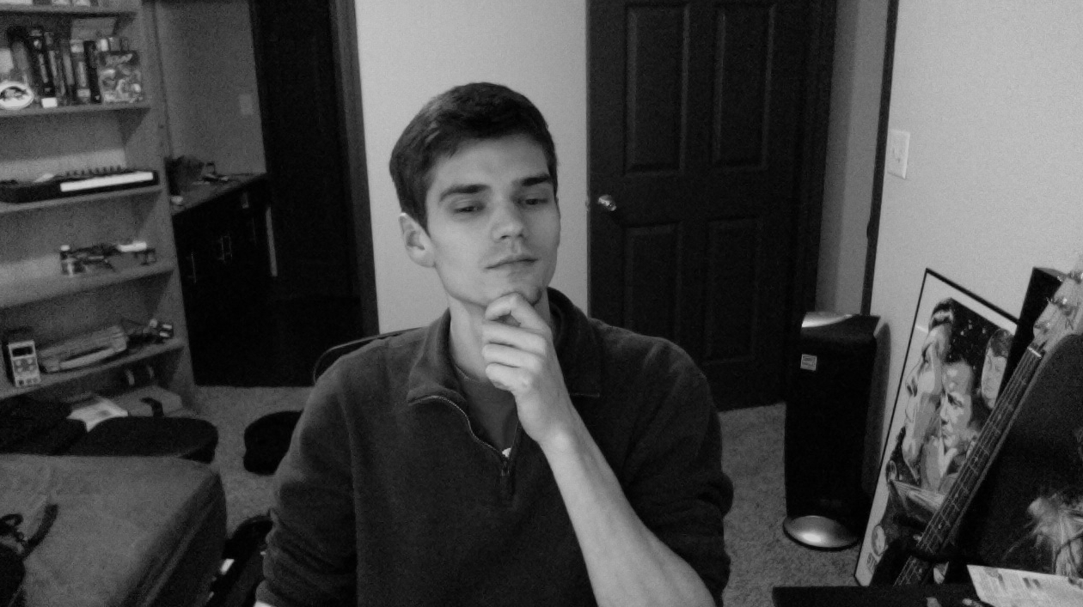
Greyscale
A greyscale image is exactly what it sounds like
It can be represented by using 2 or 3 dimensions:
[Height][Width][1]
[Height][Width]
The only difference is how the elements are accessed, but sometimes you will need to switch between the two.

Slide 6
Dealing with images in python
OpenCV is an open source library implementing all kinds of functionality for computer vision
Image format conversion
Object detection
Motion tracking
Primitives such as edge detection
Accessible in python!

Slide 7
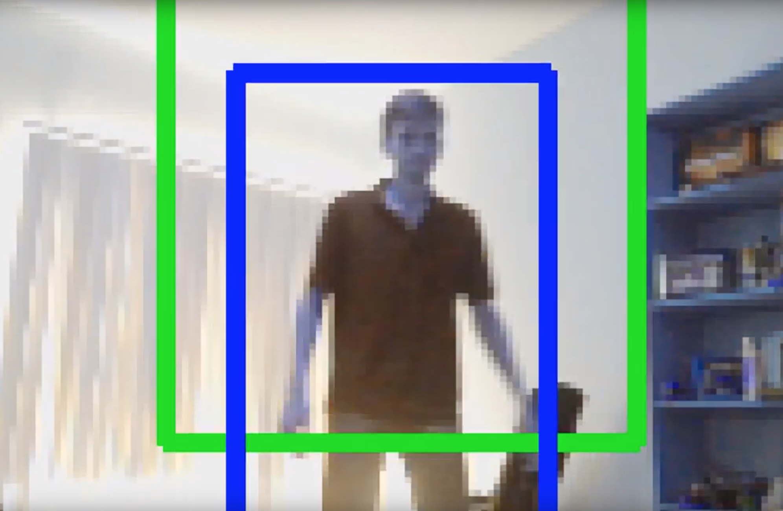
Example OpenCV Application
Here is an example using OpenCV to track objects with motion detection and object detection
https://www.youtube.com/watch?v=7Tb6nidiBTE

Slide 8
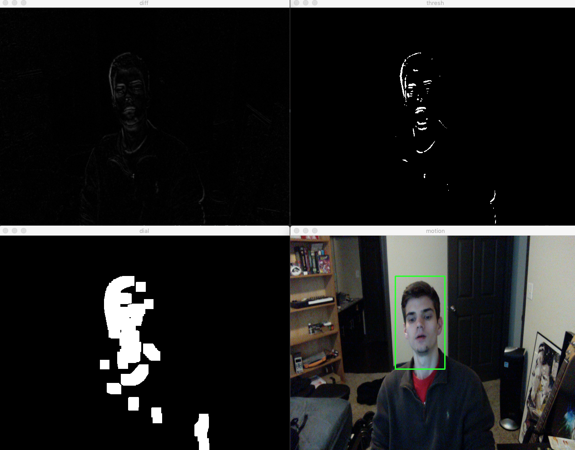
How to do motion detection with OpenCV?

Slide 9
Motion Detection With OpenCV
Convert image to grayscale (color not necessary for motion detection)
Calculate absolute difference between final and initial frame
Threshold cutoff for pixel intensity
Dilate pixels that made it through the cutoff
Find contours, or “regions of pixels directly connected to eachother”
Filter contours to only include ones with a significant area
Draw a rectangle bounding the countours

Slide 10
Example Code
See the “lesson2_motion.py” file in the python folder
Download the Anconda distribution of python to run the code on your laptop:
https://www.anaconda.com
In the conda shell run
conda install opencv
pip install imutils
python lesson2_motion.py

Slide 11
Project: Home Security System
How can we use motion detection to extract useful information from an image for a home security system?
Discuss!

